Slide 1

HEALTHCARE ANALYSIS

Slide 2






OUR TEAM
S.SATVIKA Data Engineer
P.MEGHANA Data Engineer
Y.RISHITHA Data Engineer
U.ANUPAMA Data Engineer
U.LEELAVATHI Data Engineer
SCRUM MASTER

Slide 3
TABLE OF CONTENTS
1.
2.
3.
4.
5.
6.
Data Description,
Data Ingestion
Project Overview
Architecture
Healthcare data insights and analysis
End-to-end data processing flow
Overview of healthcare dataset and data ingestion
Data Cleaning
Analysis
Visualizations
Ensuring data quality and accuracy
Spark SQL
PySpark DataFrame
PySpark RDD
Spark Streaming
Hive
Interactive dashboards using Power BI

Slide 4

1
Project Overview

Slide 5
PROJECT OVERVIEW
This project focuses on analysing healthcare data to understand disease patterns, patient demographics, and treatment trends. An end-to-end data pipeline is built using Apache NiFi for data ingestion, Pyspark and Spark SQL for data processing, Hive for data storage, and Power BI for visualization. The project helps transform raw healthcare data into meaningful insights that support better decision-making and healthcare planning.

Slide 6
2
Architecture

Slide 7
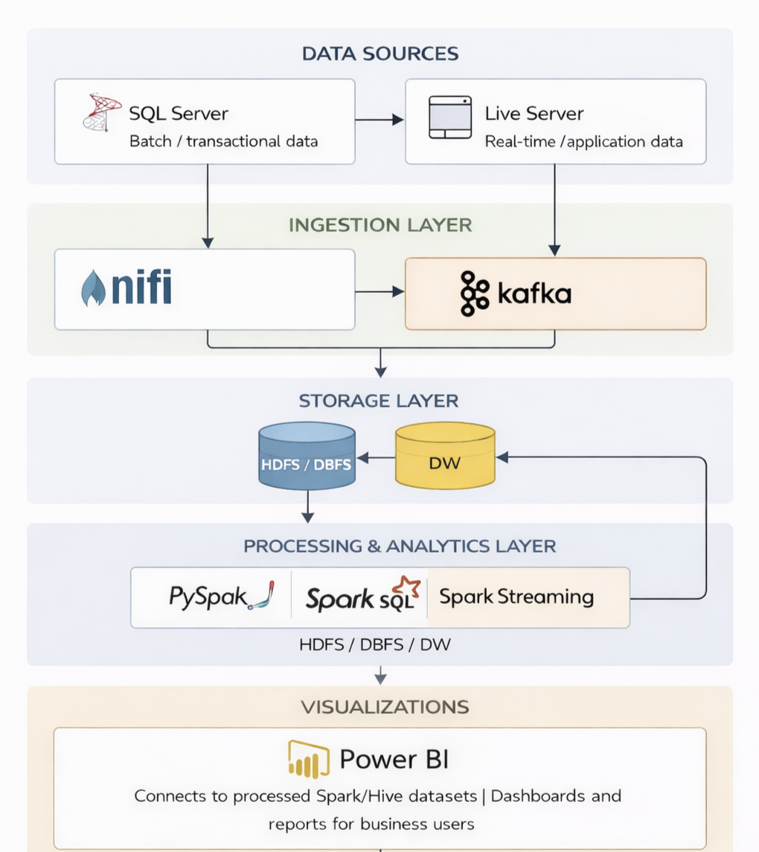

Slide 8
3
Data Description, Data Ingestion

Slide 9
Table Name | Description
Pharmacy | Stores pharmacy details like name, phone number, and location.
Prescription | Links a treatment to a pharmacy; records which medicines were prescribed.
Treatment | Captures when and why a patient was treated, including disease and insurance.
Claim | Holds insurance claim details, including balance and linked insurance plan.
Disease | Contains disease names and descriptions.
InsurancePlan | Holds insurance plan details and links to the company offering it.

Slide 10
Medicine | Stores medicine details including name, type, pricing, and manufacturer.
Patient | Stores patient-specific info like ID, date of birth, and SSN.
Person | General person info (name, gender, phone) linked to an address.
Address | Stores address details used by people, pharmacies, and companies.
InsuranceCompany | Contains insurance company names and their addresses.
Keep | Tracks which pharmacies stock which medicines and in what quantity.
Contain | Contains prescription, medicineID,quantity.

Slide 11
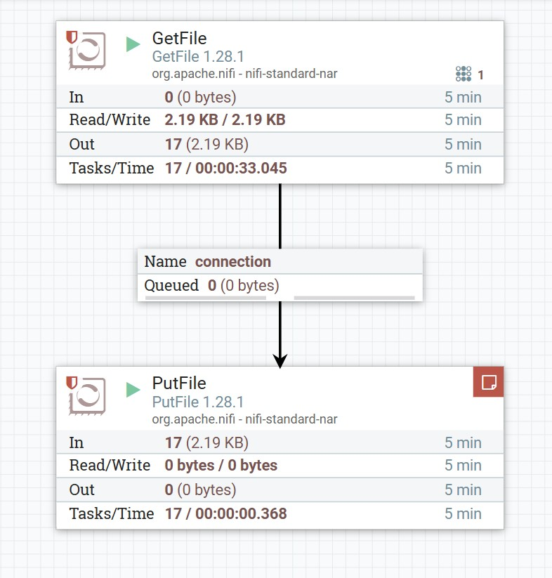
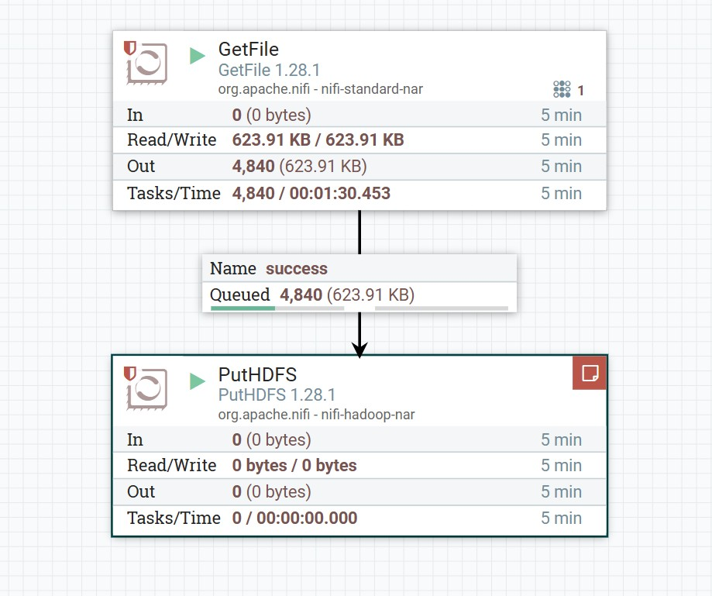
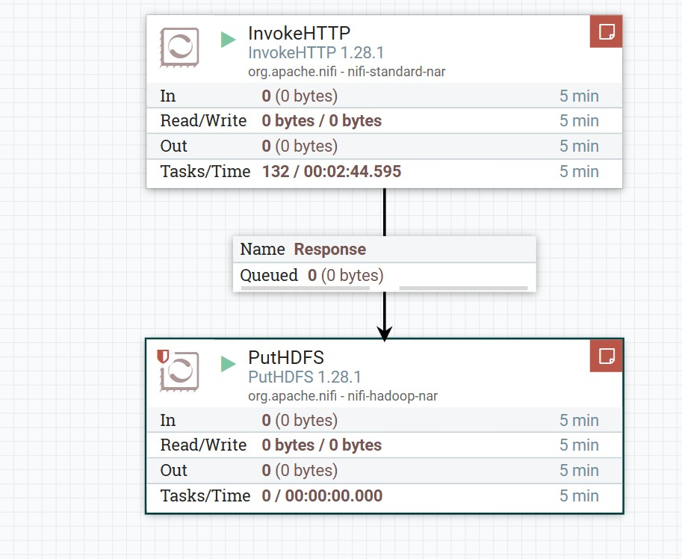

Data Ingestion using NIFI

Slide 12
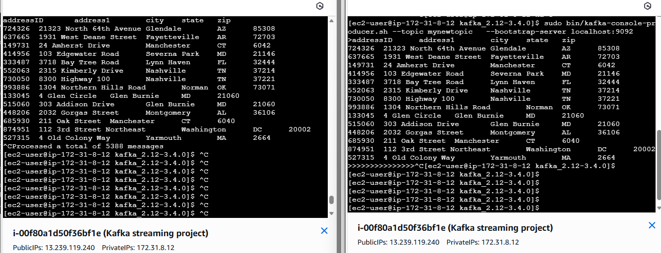

Data Ingestion using KAFKA

Slide 13
4
Data Cleaning

Slide 14
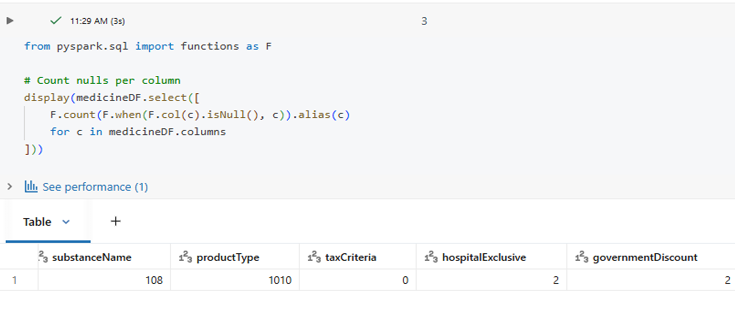
Before Data Cleaning

Slide 15
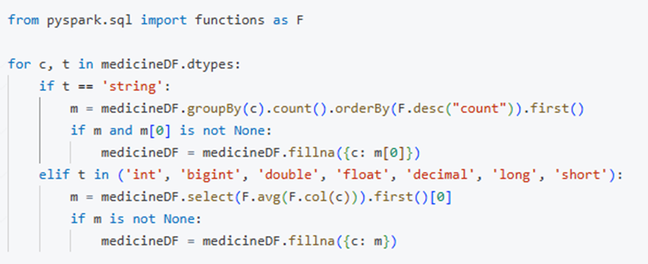
Data Cleaning

Slide 16
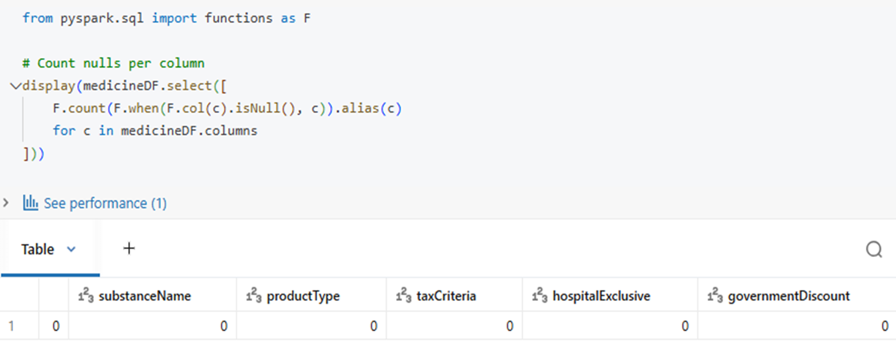
After Data Cleaning

Slide 17
5
Analysis

Slide 18
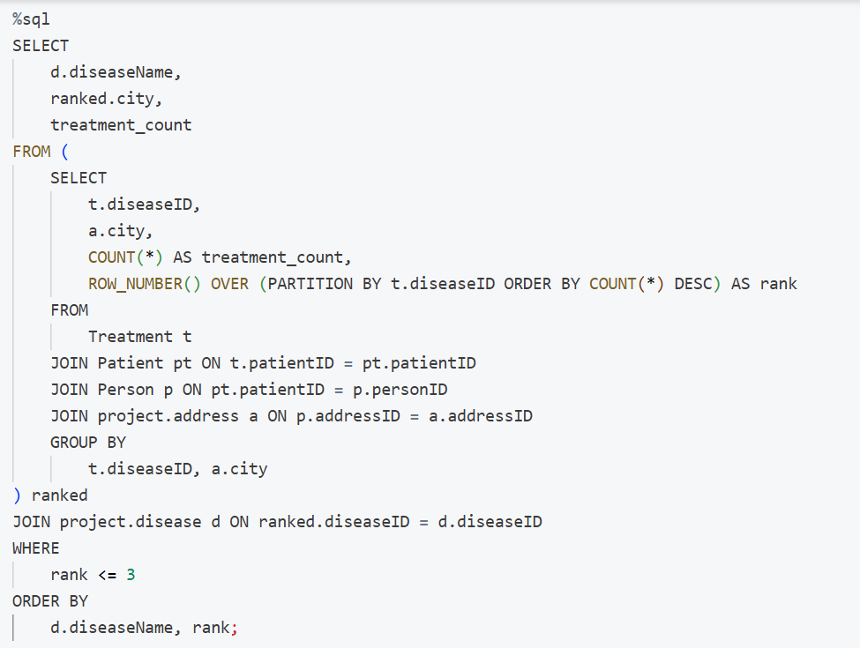
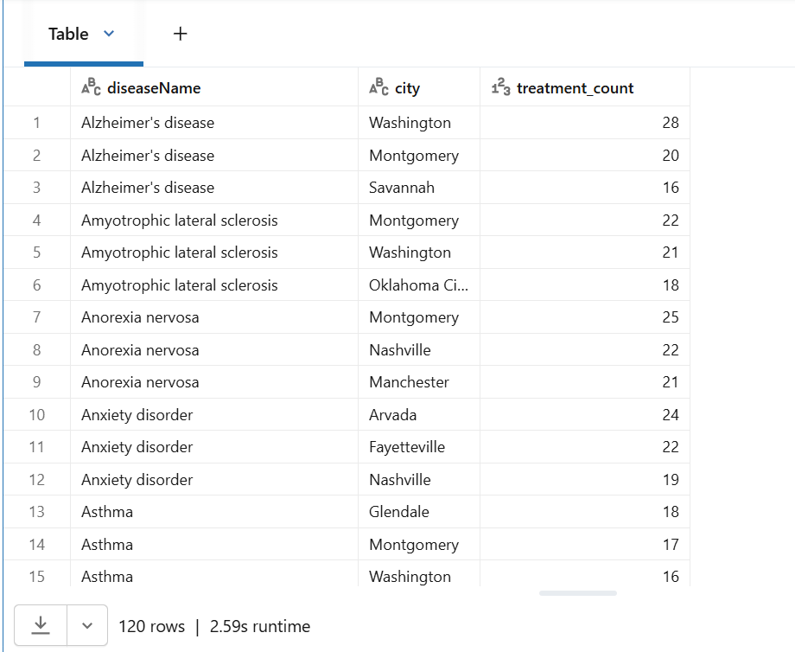

Spark SQL
Kelly, from the Fortis Hospital management, has requested a report that shows for each disease, the top 3 cities that had the most number treatment for that disease.

Slide 19
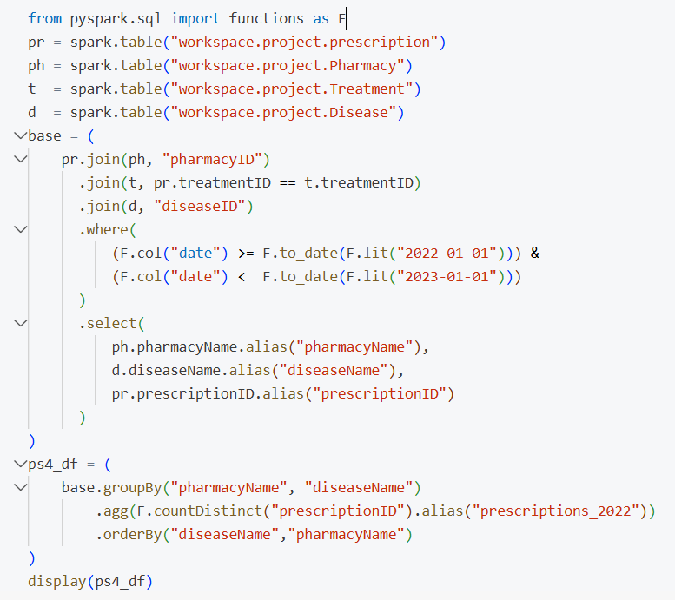
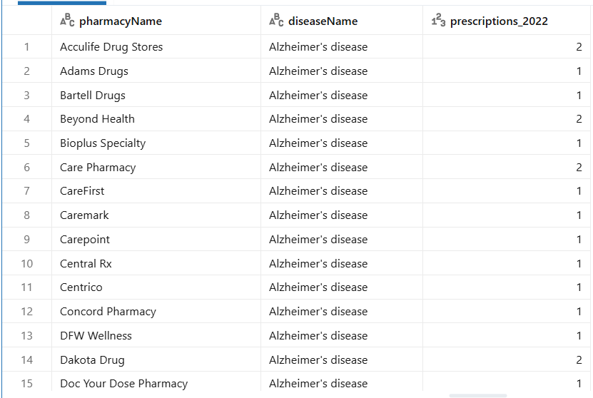

PySpark DataFrames
Jackson wants a 2022 pharmacy report showing prescription counts per disease, per pharmacy, and overall totals.

Slide 20
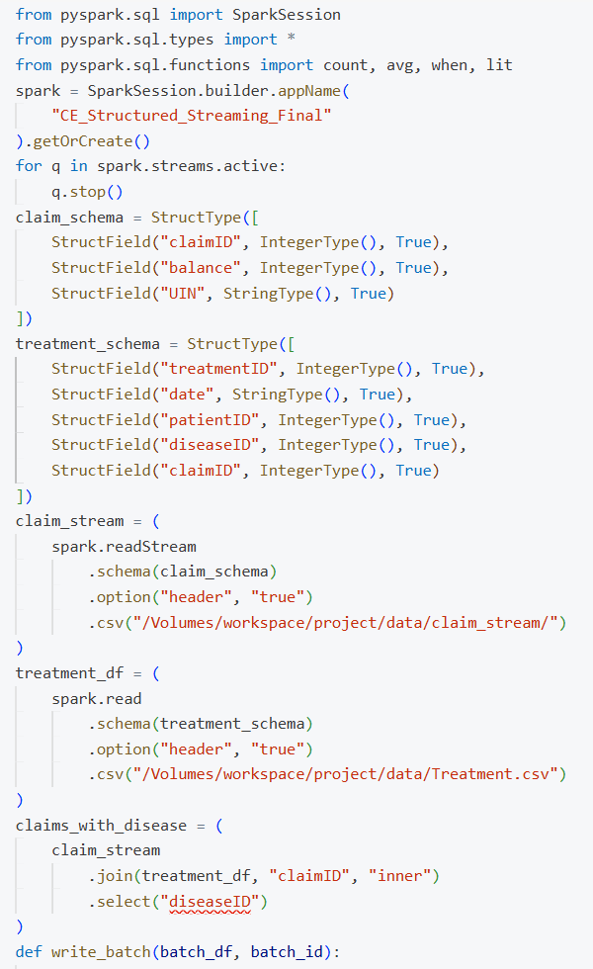
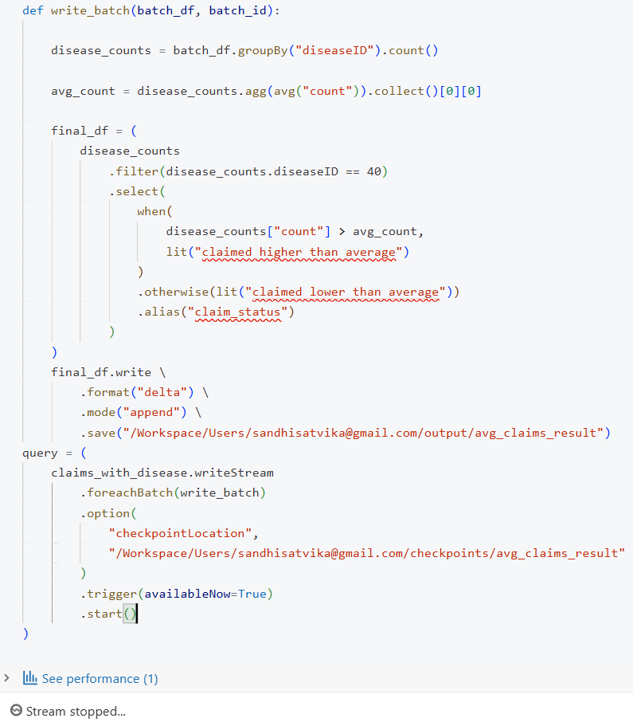
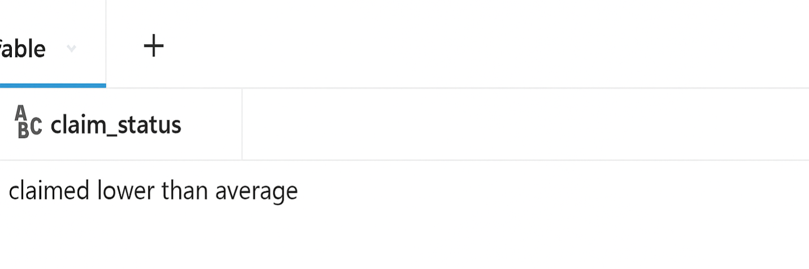
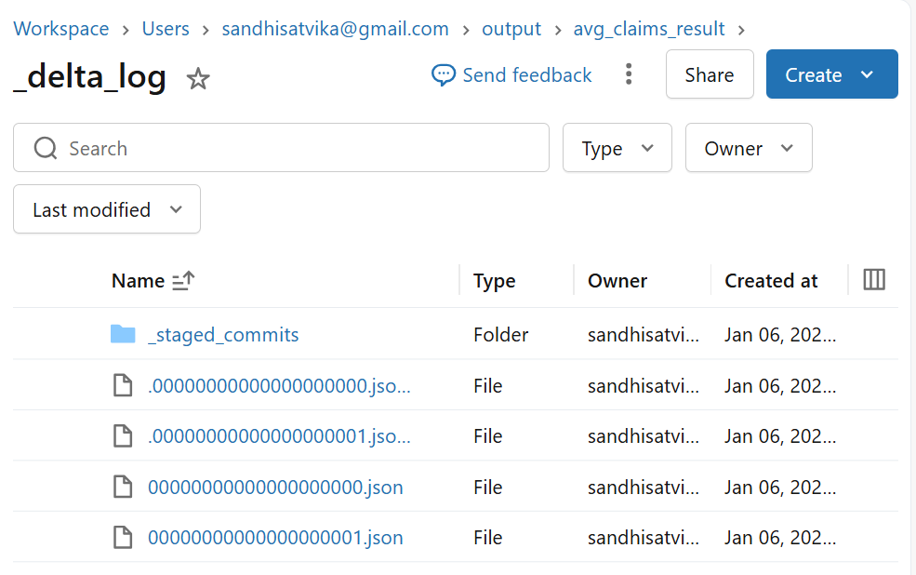
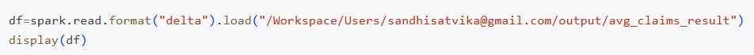
SparkStreaming
Returns whether a given diseaseID is claimed higher or lower than average.

Slide 21
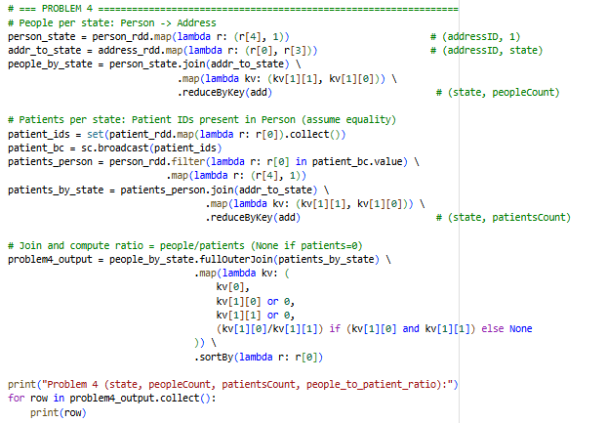
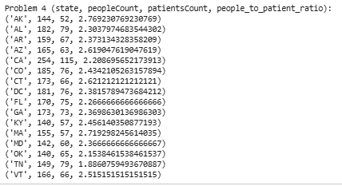
PySpark RDD’s
The healthcare department wants a state-wise report showing people, patients, and their ratio, sorted by ratio.

Slide 22
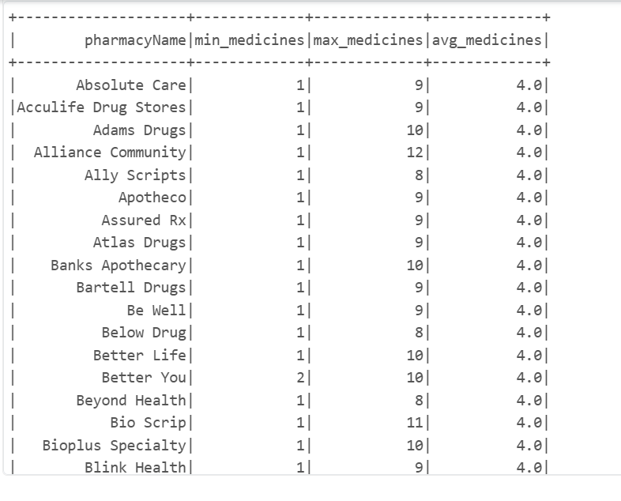
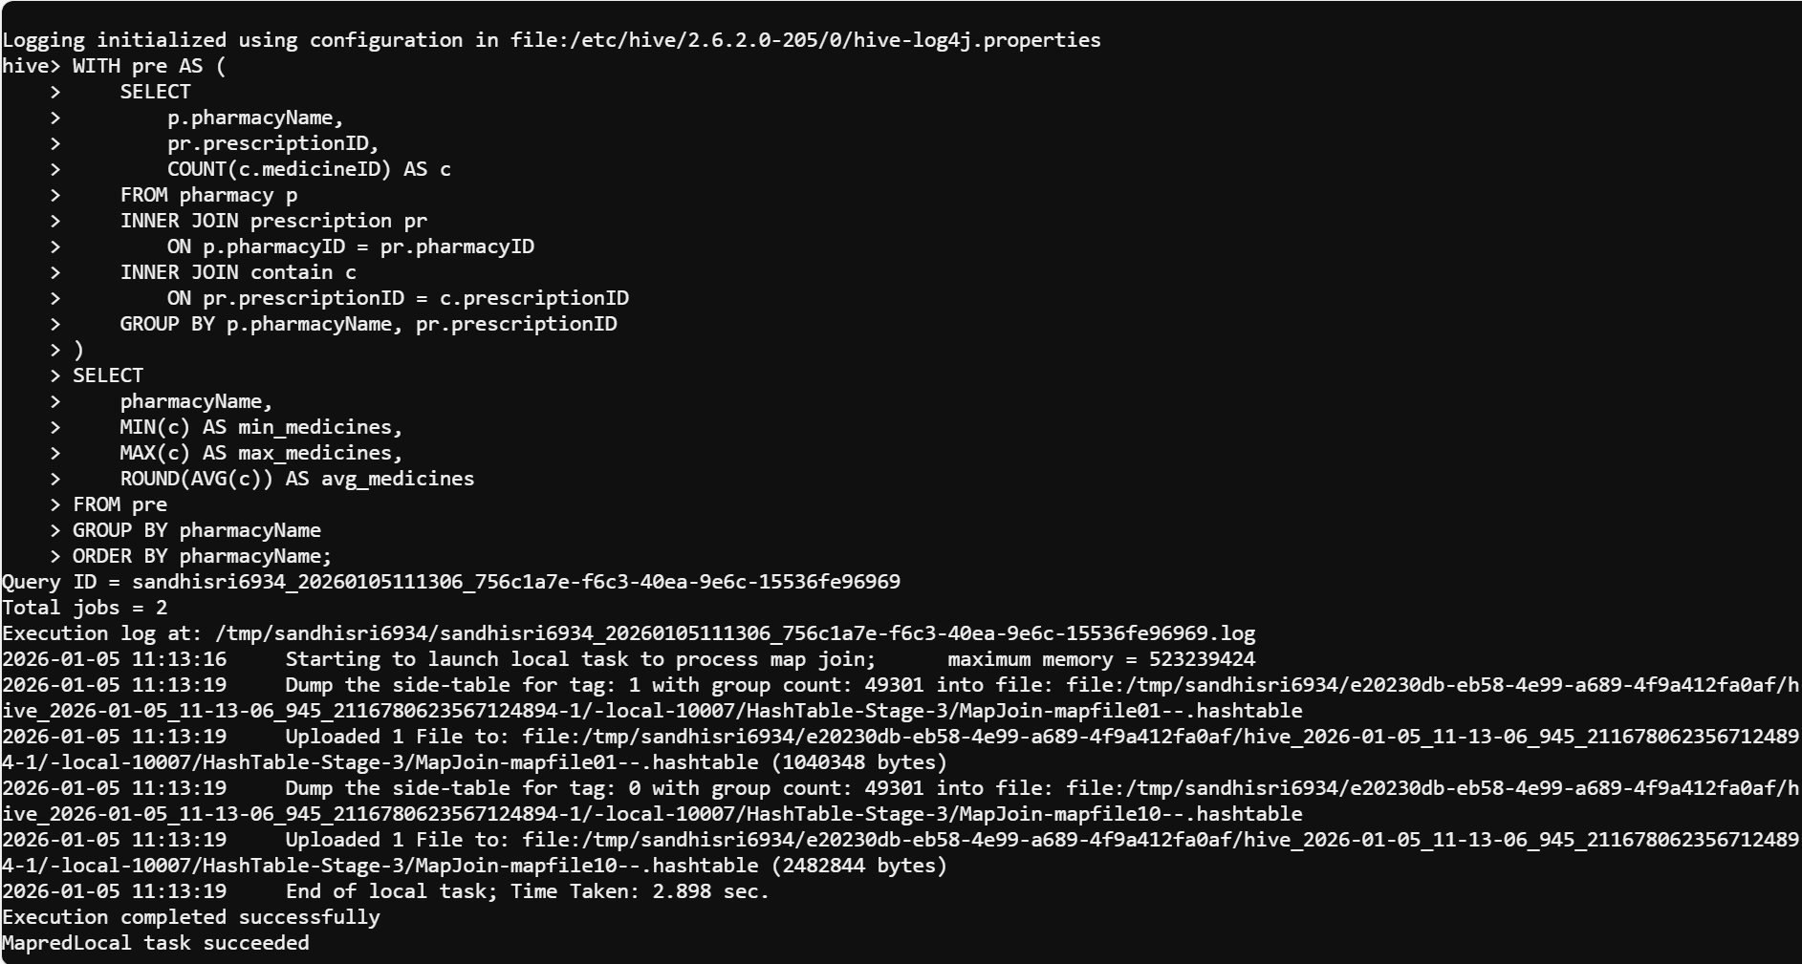

HIVE
The Healthcare department wants a pharmacy inventory report showing medicine units and average number of medicines

Slide 23
6
Visualizations

Slide 24
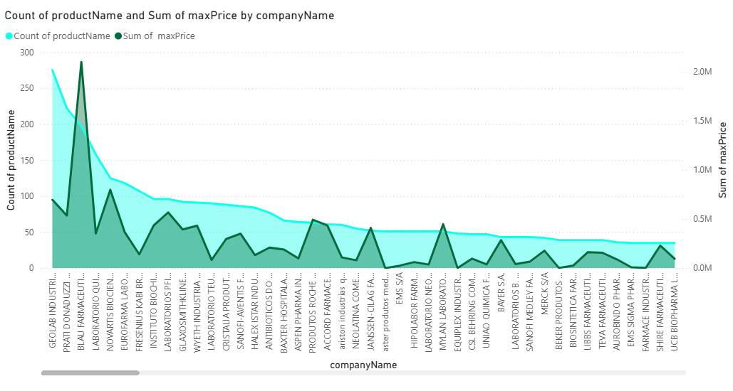
Count of ProductName and sum of maxPrice by CompanyName

Slide 25
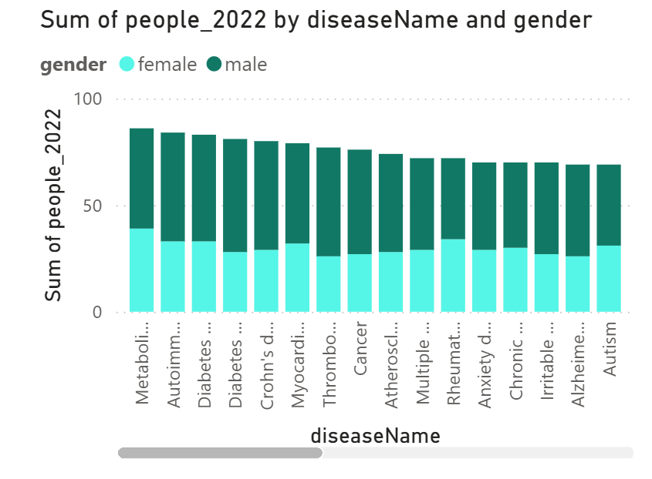

Slide 26
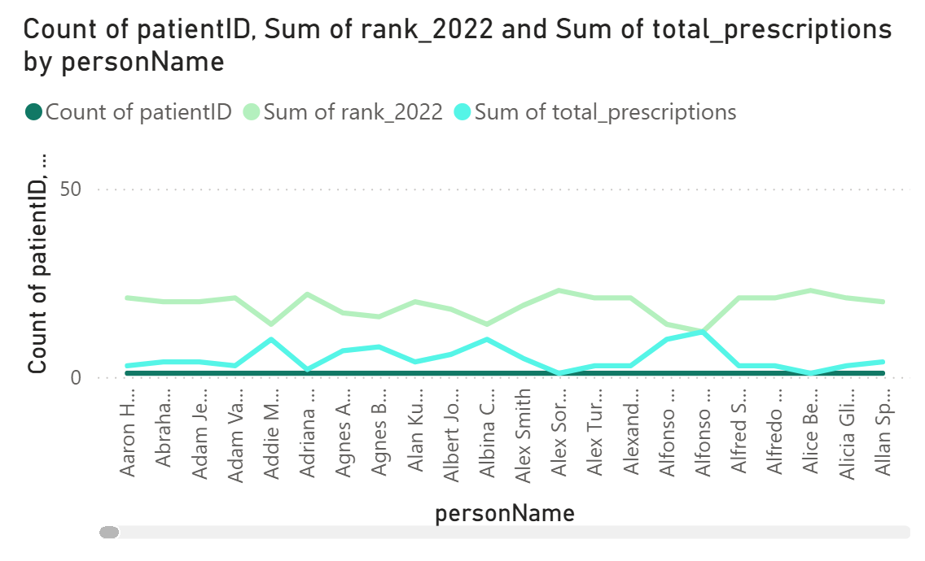

Slide 27
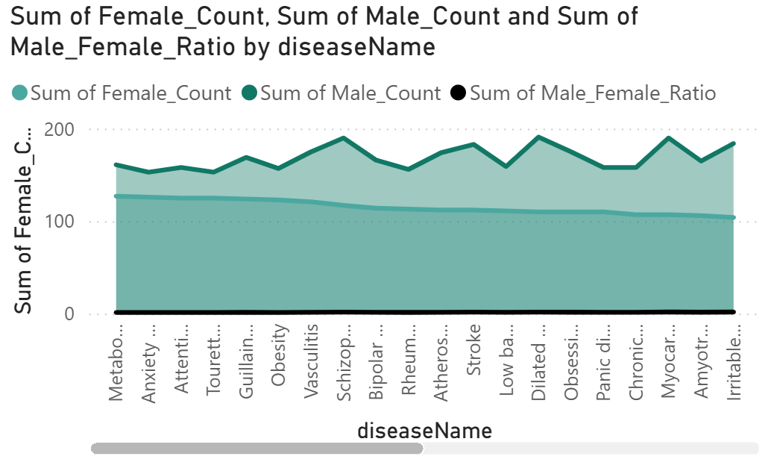

Slide 28
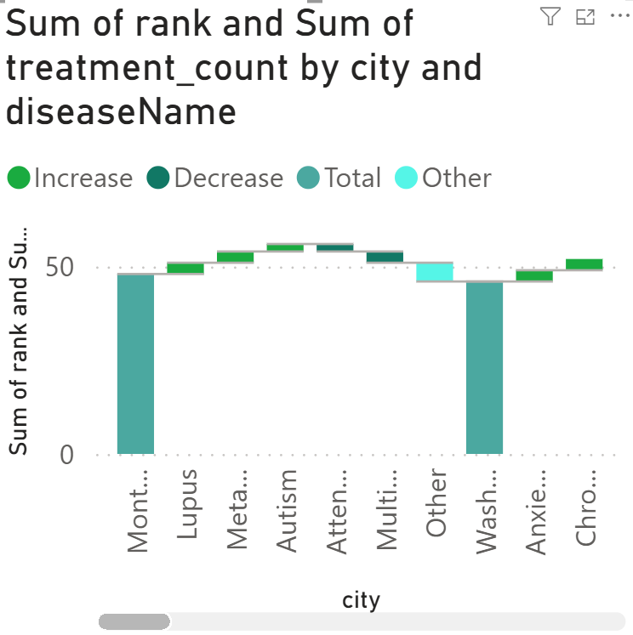

Slide 29
CHALLENGES
Data Quality Issues Inconsistent, incomplete, or duplicate records in healthcare datasets.
Data Integration Complexity Combining data from multiple sources (pharmacy, insurance, patient records).
Handling Large Volumes of Data Managing and processing big data efficiently using Spark and Hive.
Real-Time Data Processing Implementing streaming solutions for timely insights.
Privacy & Compliance Ensuring patient data security and adherence to healthcare regulations.
Visualization & Interpretation Creating meaningful dashboards for non-technical stakeholders.

Slide 30

CONCLUSION
“Data-driven insights for improved healthcare outcomes.”

Slide 31

Thankyou!

Slide 32
ANY DOUBTS !!!!!!

